Slide 1
Introduction to Node JS

Slide 2
What is Node.JS
Node.js is an open-source, cross-platform JavaScript runtime environment that executes JavaScript code outside of a web browser. It’s a powerful tool used for various types of projects.

Slide 3
Why Node.JS?
Node.js is used to build back-end services like APIs like Web App, Mobile App or Web Server. A Web Server will open a file on the server and return the content to the client. It’s used in production by large companies such as Paypal, Uber, Netflix, Walmart, and so on.
Reasons to Choose Node.js
Easy to Get Started
Scalability
Real-Time Web Apps:

Slide 4
How Node.JS Works?
Node.js accepts the request from the clients and sends the response, while working with the request node.js handles them with a single thread. To operate I/O operations or requests node.js use the concept of threads. Thread is a sequence of instructions that the server needs to perform. It runs parallel on the server to provide the information to multiple clients. Node.js is an event loop single-threaded language. It can handle concurrent requests with a single thread without blocking it for one request.

Slide 5
What is “Event Loop
According to MDN: “The event loop is queue of callback functions. When an async function executes, the callback function is pushed into the queue. The javascript engine does not continue processing the event loop until the code after an async function has executed.

Slide 6
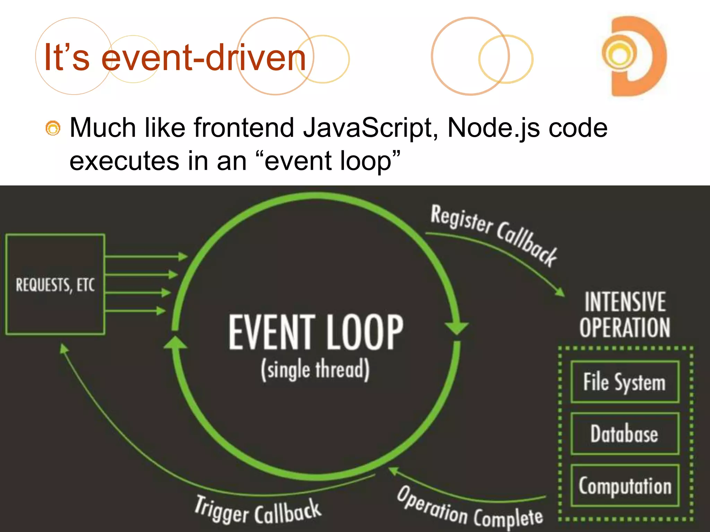
It’s event-driven

Slide 7
Node.js - Callbacks Concept
A Callback in Node.js is an asynchronous equivalent for a function. It is a special type of function passed as an argument to another function. Node.js makes heavy use of callbacks. Callbacks help us make asynchronous calls. All the APIs of Node are written in such a way that they support callbacks.
The setTimeout() function in Node.js is a typical example of callback. The following code calls the asynchronous setTimeout() method, which waits for 1000 milliseconds, but doesn't block the thread. Instead, the subsequent Hello World message, followed by the timed message.

Slide 8
Node.js - Events
Node.js identifies several types of events. Each event can be attached to a callback function. Whenever an event occurs, the callback attached to it is triggered. The Node.js runtime is always listening to events that may occur. When any event that it can identify occurs, its attached callback function is executed.
The Node.js API includes events module, consisting mainly the EventEmitter class. An EventEmmiter object triggers (or emits) a certain type of event. You can assign one or more callbacks (listeners) to a certain type of event.

Slide 9
Node.js - Global Objects
Global objects in Node.js are built-in objects. The Node.js runtime is made up of a number of core modules. To incorporate the functionality of any of the core modules such as fs module, or http module (or any external module installed from npm – such as express module), you need to load the same with require() function. However, some modules, functions, classes, variables etc. can be used directly in the JavaScript code, without loading them with require() functions. They are called Global objects. Let us take a look at the global classes, variables and functions in Node.js

Slide 10
Node.js - Scaling Application
Scalability of a Node.js application refers to its ability to handle increasing workload on the server with a greater number of requests received from clients. A Node.js application can utilize child processes to address this issue. A child process is a separate instance of the Node.js runtime that can be spawned and managed by the main process. Such a spawned child process can perform specific tasks parallel, thereby it improves the overall performance and scalability of the application.

Slide 11
Node.js - Packaging
A large-sized Node.js project usually has a number of dependencies and a number of source files as well as other assets such as images, web pages, setting files etc. To distribute a Node.js project and deploy it on any other environment becomes difficult, and hence it needs to packaged so that it can be easily ported to other machine. There are a number of packaging tools available on NPM repository.

Slide 12
Node.js - Modules
A module in Node.js is a collection of independent and reusable code that can be imported into any Node.js application. As the name suggests, modules enable a modular and structured approach for developing a Node.js application. Instead of putting all the functions, classes and methods of an application in a single .js file, these resources are arranged in separate files (called modules) based on their relevance. This gives a better control over the maintenance and troubleshooting of the Node.js application.

Slide 13
Thank You

